Slide 1

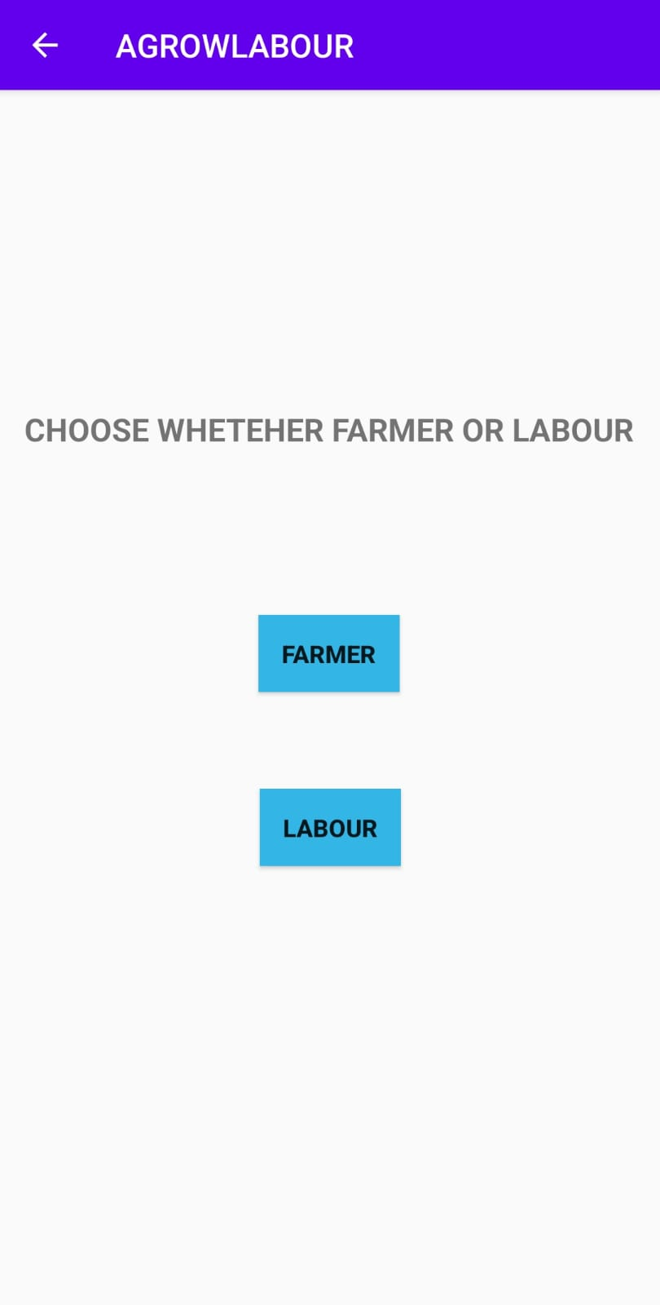
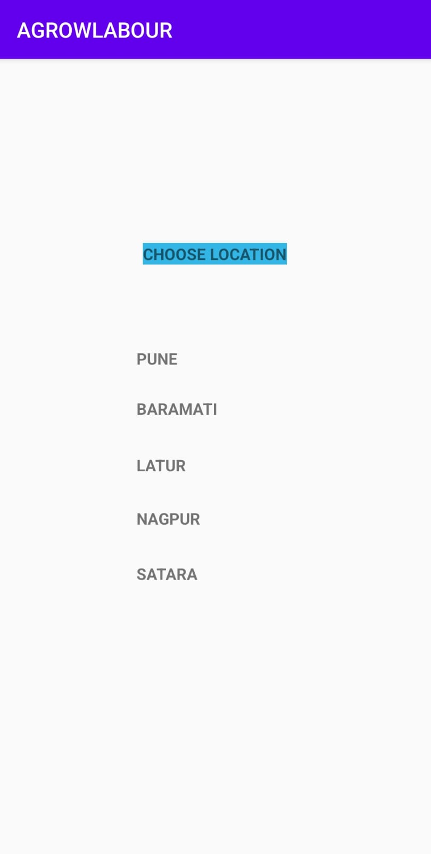

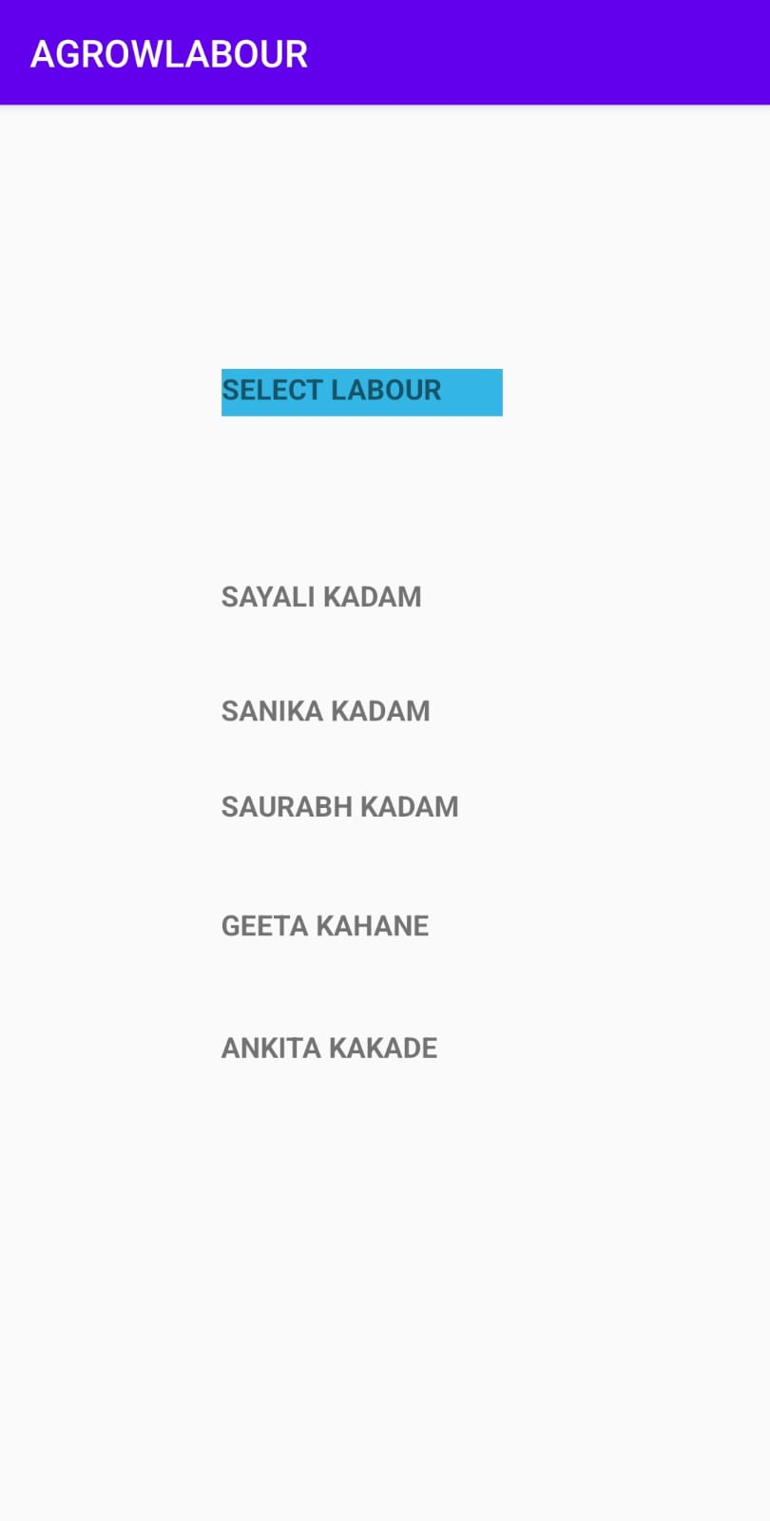
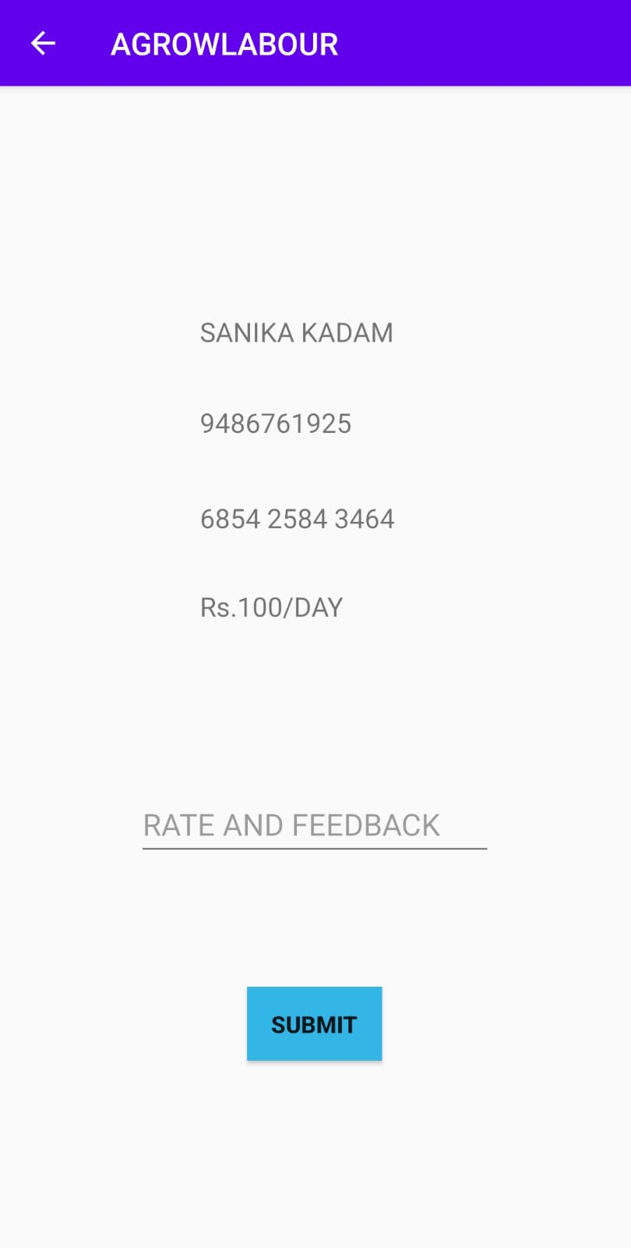
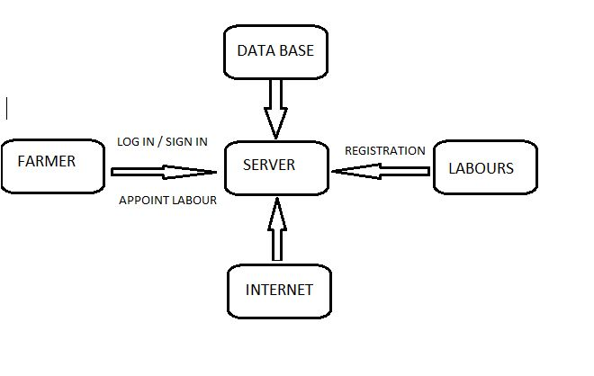
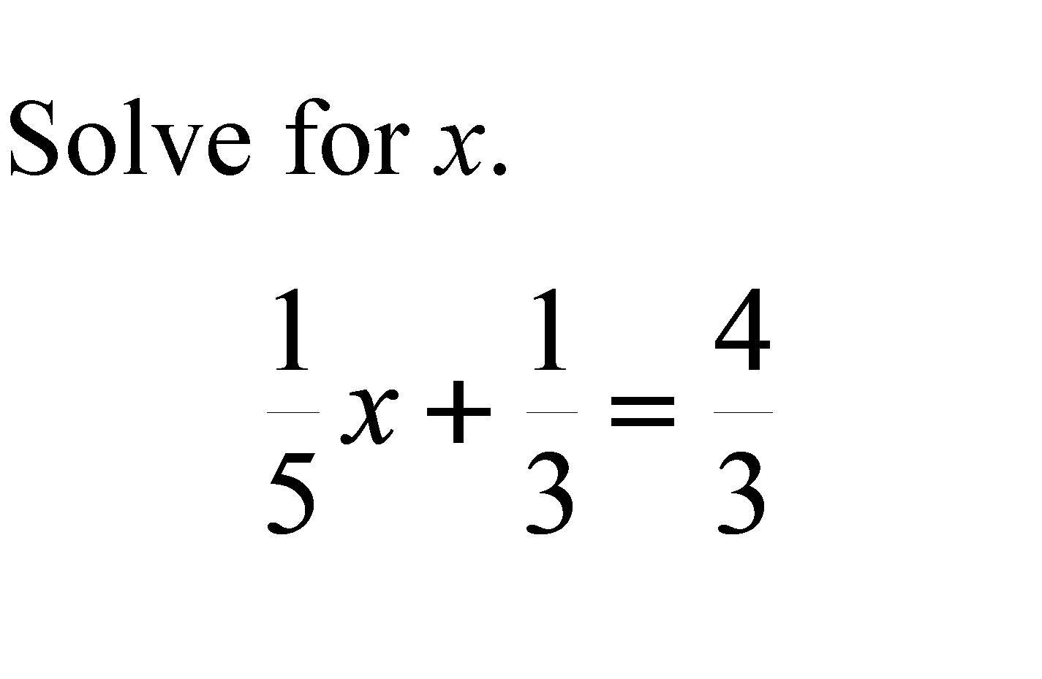
EDAI1 PROJECT
GROUP NO
H12
Project Title:- ANDROID MOBILE APP
Title:- AGROWLABOUR
Authors:- Palomi Gawali, Sanika kadam, Saurabh kadam, Sayali kadam
,Geeta kahane, Ankita kakade,
Department of Engineering Sciences and Humanities (DESH)
Vishwakarma Institute of Technology, Pune - 411037
Introduction
ABSTRACT - max 75 words
RESULTS AND DISCUSSIONS
As the name suggest , Agrowlabour is an app which will act as a direct link between farmers and labors. The farmers often find it difficult to hire labors for their farmwork. Even the labors find difficulty in employment. Our app will help both of them to register online and contact each other on a direct online basis , where there is no in-between agents or broker. It will reduce unemployment and child labor.
The app will ensure easy communication between labors and users of the app.
It will help to solve the problem of unemployment
It will prevent child labor.
It will help in reduction of poverty.
There won’t be any in-between agent or broker.
It is safe and trustworthy for the labors.
It is easy and convenient to use
INTRODUCTION – 100 words
The purpose of agrowlabour is e-farming. The labor has to register using basic details i.e. name, phone no., Aadhar no and location. Similarly, the farmer will sign-in/log-in and search for labor in his near-by area. The farmer will contact the labor and accordingly appoint him. The payment will be done in online mode. Database will store the information regarding farmers, labors, location , their name and rest details.
APP LOGO
METHODOLOGY / DESIGN
BLOCK DIAGRAM
APP DEMO
NOVELTY FEATURES / FINDINGS
ALGORITHM / FLOW CHART / CIRCUIT DIAGRAM
Such an app for hiring labors has not been invented and implemented yet. This app will provide an opportunity for labors to uplift the level of their lifestyle.
Literature survey.
Analyzing research paper.
Collection of database.
Creating app logo.
Creating farmer UI.
CONCLUSIONS
This app will be direct link between farmers and labors.
It will help in resolving the problem of labor shortage.
It will be easy for the labors to register by just filling three basic details.
It will be trustworthy even in case of payment methods.

